Slide 1
2023 Sustainability Report
Deborah Moran, Sustainability Manager, Department of Community Development
Town Council Work Session
10 03, 2023

Slide 2
Overview
What to Expect
Previous Success
Current Measures
What’s Next

Slide 3
What to Expect?
Annual Reports beginning January 2025
Expansion to include additional topics

Slide 4
Previous Success
Tree City
Keep Leesburg Beautiful
LED Lights
Stream Restorations
Electric Vehicles
ICLEI Membership
EnergyCAP

Slide 5
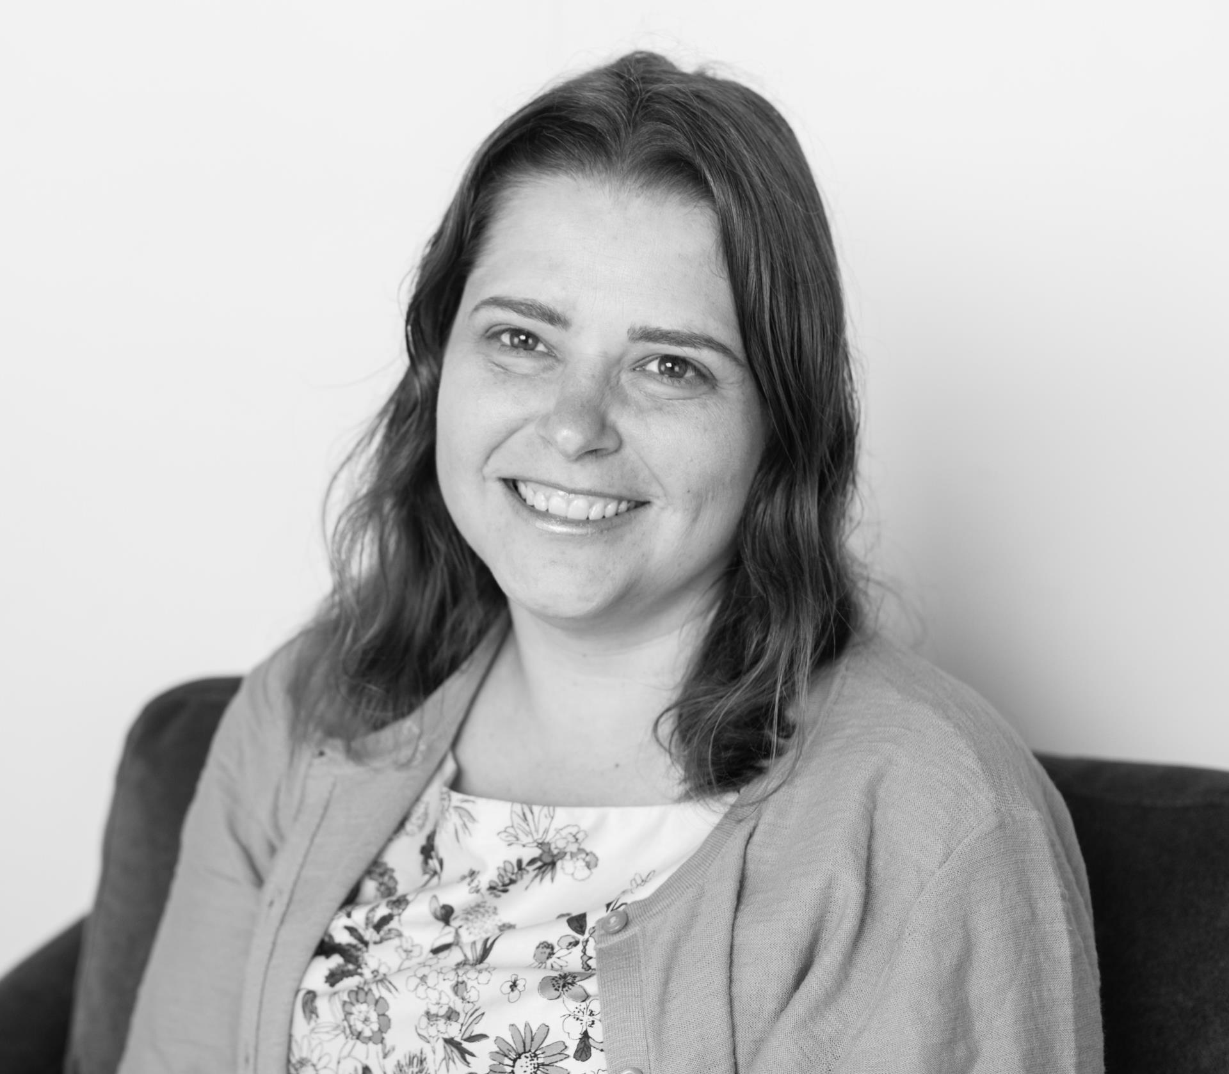
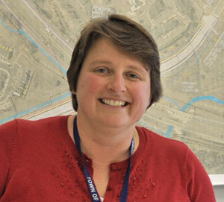
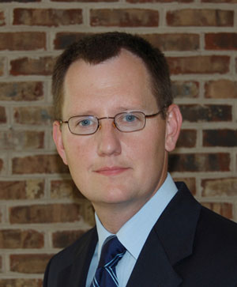
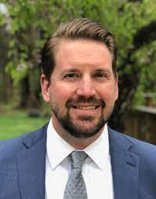
Current Measures
Sustainable Government Operations
Vision. Efficiently managed town resources that meet the needs of all our residents while minimizing impacts on the environment.
Mission. Support sustainable government operations that integrate environmentally conscious decision-making into Town operations.

Slide 6
Current Measures: Energy

Slide 7
Current Measures: Fleet
484 assets
136,000 gallons of fuel

Slide 8
Current Measures: Emissions
Notes:
7701

Slide 9
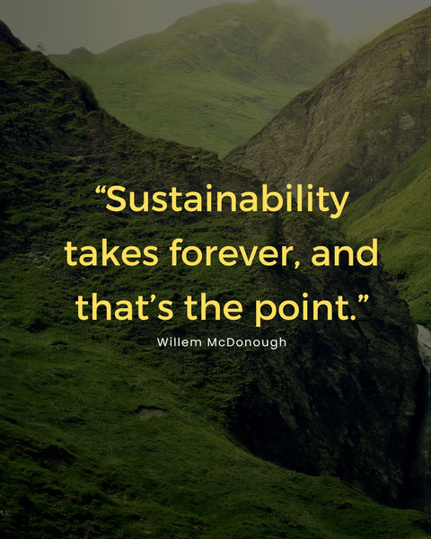
What’s Next
Notes:
Short term goals- eecs, better tracking
Long term goals – facilities master plan, climate action plan, alternative fuel plan

Slide 10
Questions & Answers

